Slide 1
Comorbidities and Mortality with Frailty among CKD patients
20180913
Patrick Yihong Wu

Slide 2
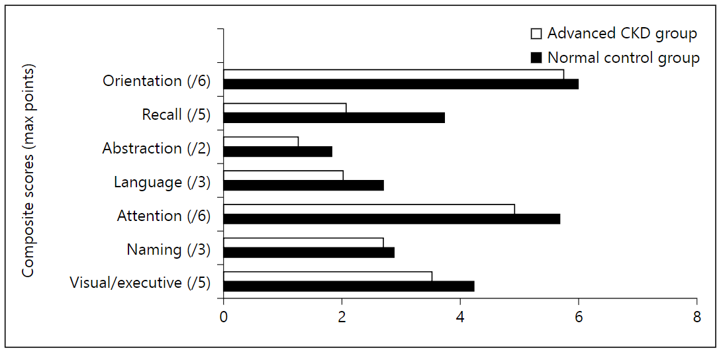
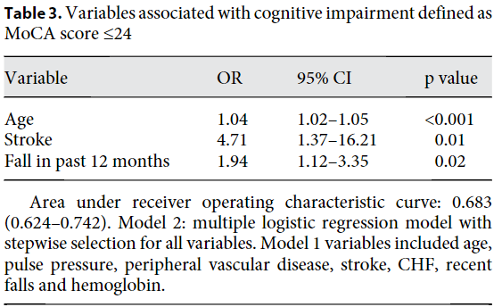
Probable correlations
References | Group/Method | Probable comorbidities
Foster, R. et al. (2016). Cognitive Impairment in Advanced Chronic Kidney Disease: The Canadian Frailty Observation and Interventions Trial. Am J Nephrol, 44(6), 473-480. doi:10.1159/000450837 | The Canadian Frailty Observation and Interventions Trial / MoCA score using the t test and Mann–Whitney U test | Cognitive impairments
Walker, S. et al. (2015). Frailty and physical function in chronic kidney disease: the CanFIT study. Can J Kidney Health Dis, 2, 32. doi:10.1186/s40697-015-0067-4 | Canadian Frailty Observation and Intervention Trial / Self-reported and Case Summary reported | Self-reported: Asthma, Arthritis, Visual Impairment, Hearing Impairment, Depression, Anxiety/Panic Attacks, Malignancy, and Psychological Stress/Acute Disease. Case summary reported: Myocardial Infarction (MI), Prior angioplasty or stent, Prior cardiac surgery, Diabetes (Type I or II), Hypertension, Dyslipidemia, Peripheral Arterial Disease, Stroke, Cerebrovascular disease (i.e., Transient Ischemic Attack), Other Neurologic Disease (i.e., Parkinson’s, Alzheimer’s, Huntington’s or Multiple Sclerosis), Cirrhosis, Gastro-intestinal Disease, Pulmonary Hypertension, Chronic Obstructive Pulmonary Disease (COPD), Congestive Heart Failure (CHF).
但是差異看起來有點小

Slide 3
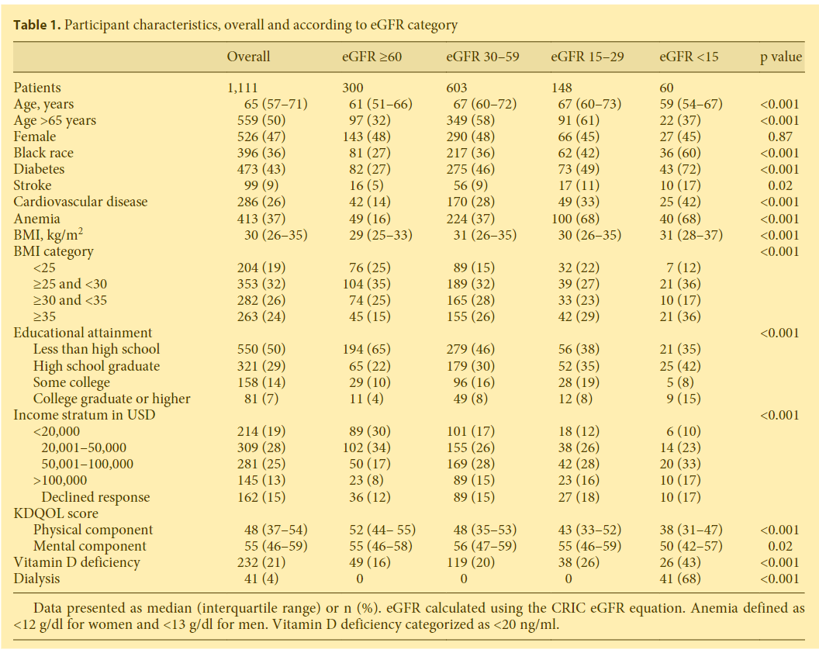
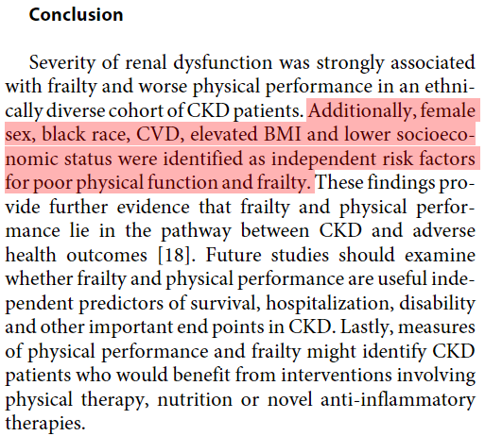
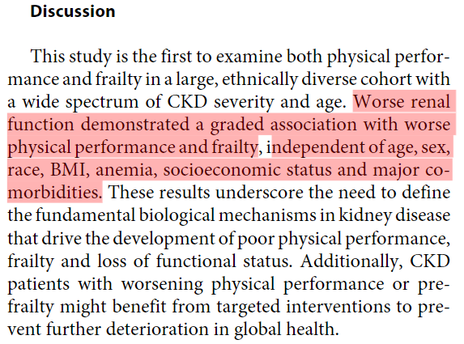
Questions about articles
Reese et al. (2013). Physical performance and frailty in chronic kidney disease. Am J Nephrol, 38(4), 307-315. doi:10.1159/000355568

